Slide 1
Task2
File created on: 11/27/2025 4:18:04 PM

Slide 2
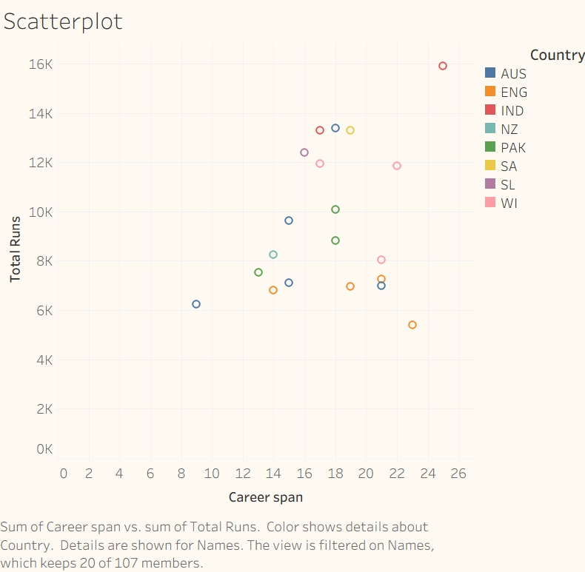

Slide 3
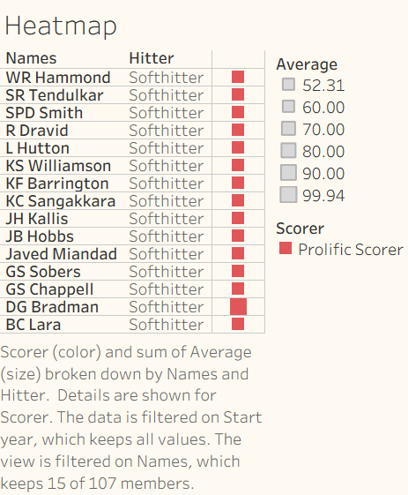

Slide 4
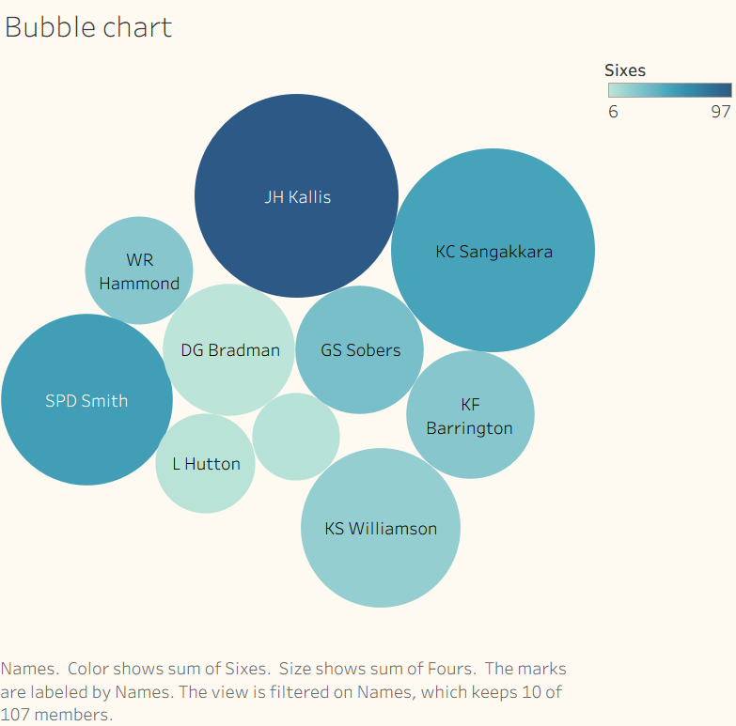

Slide 5
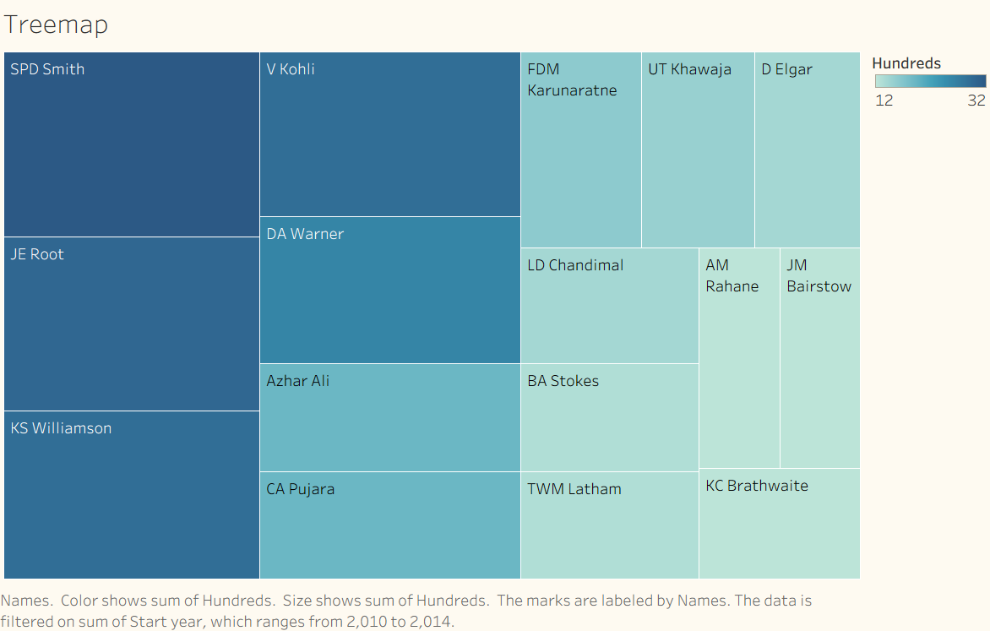

Slide 6
